Slide 1

UBER VS YELLOW TAXI
New York City 2014

Slide 2
What data was used?
Uber infomation I used the dataset that we found on Kaggle for NYC Uber 2014-2015 however for my portion of the project I solely focused on the year 2014
Yellow Taxi information was obtained from the API:
https://data.cityofnewyork.us/Transportation/2014-Yellow-Taxi-Trip-Data/gn7m-em8n

Slide 3
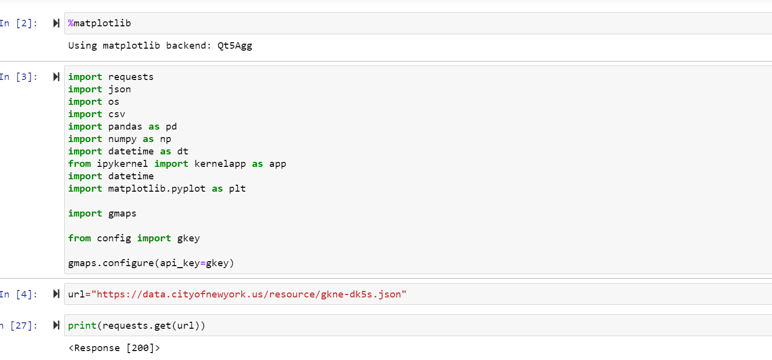
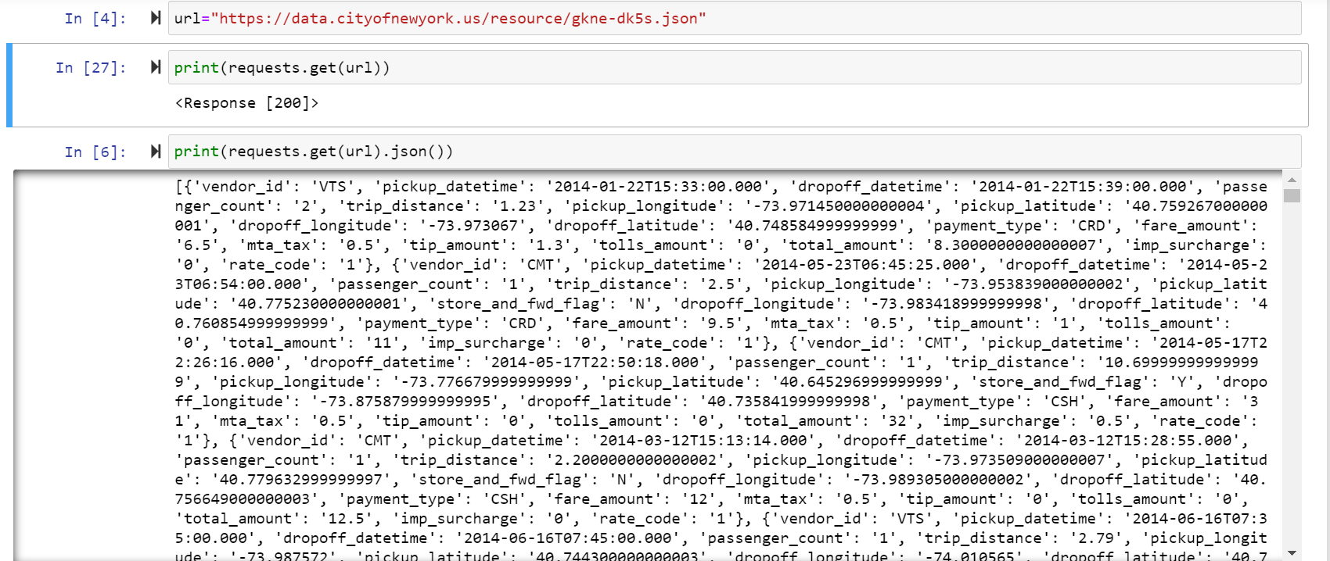

Slide 4
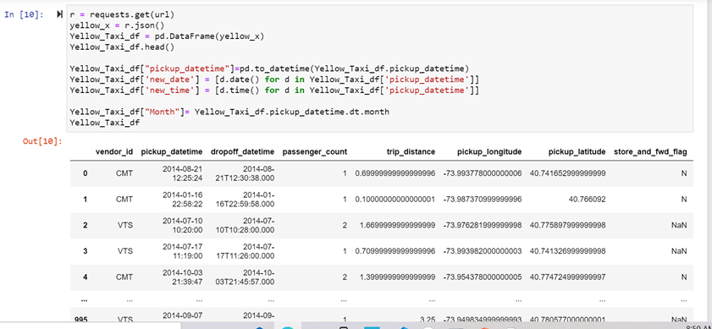
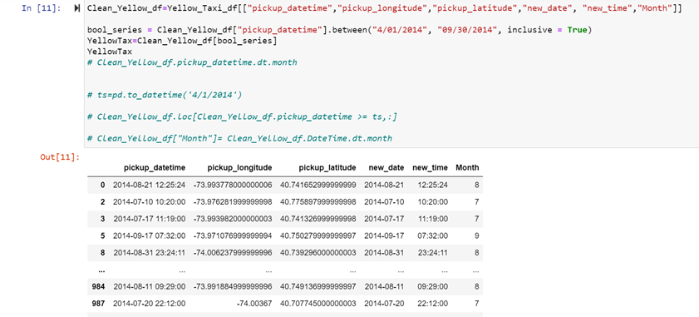

Slide 5
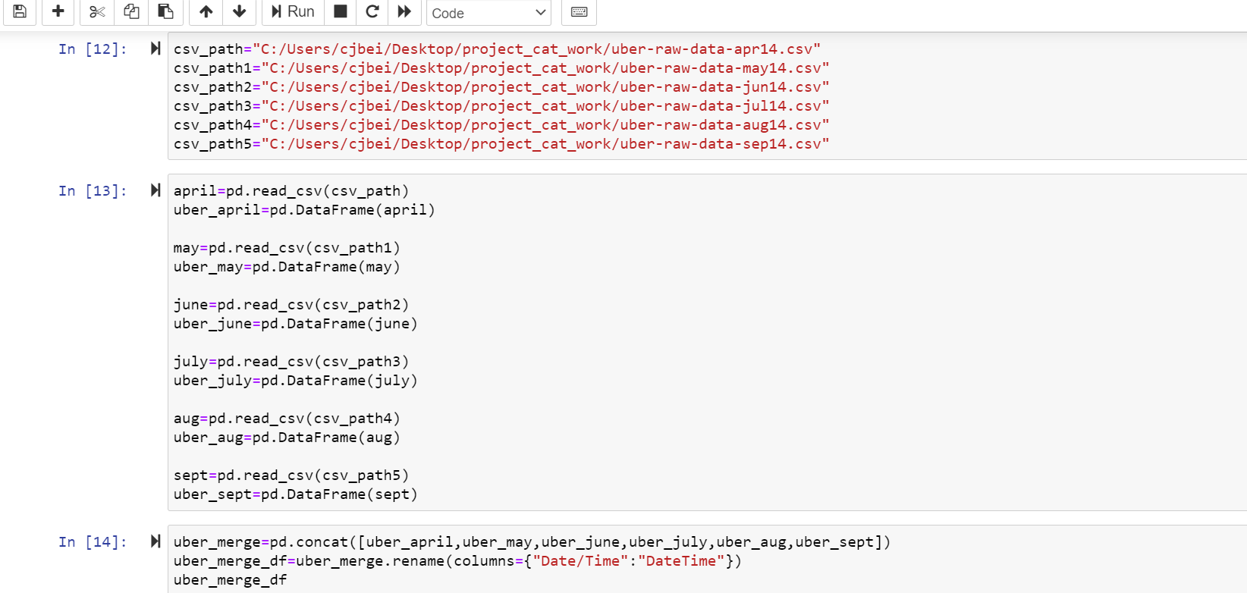

Slide 6
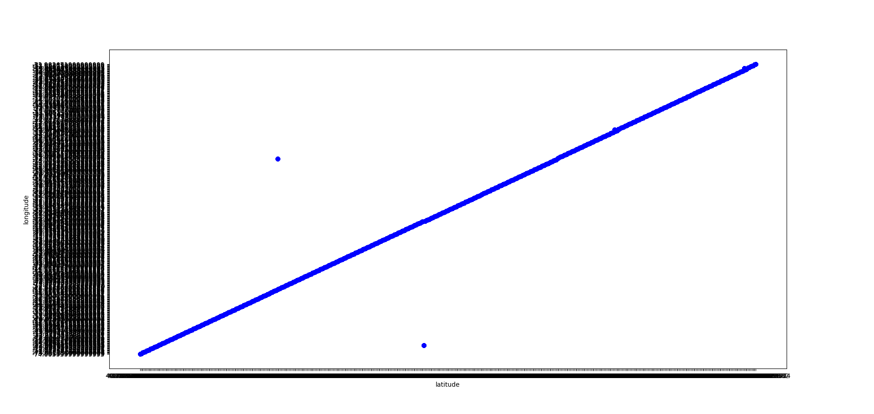
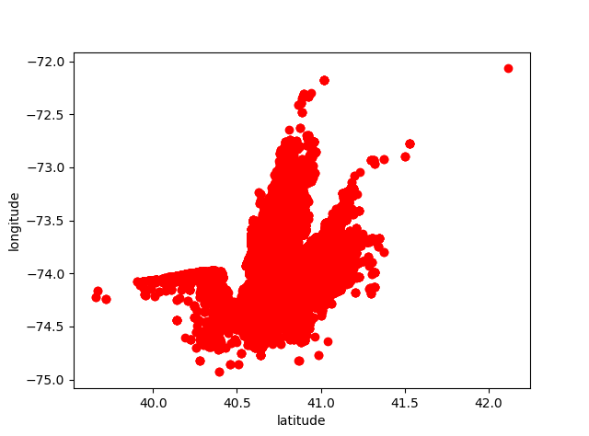
Is each service used in similar places?

Slide 7
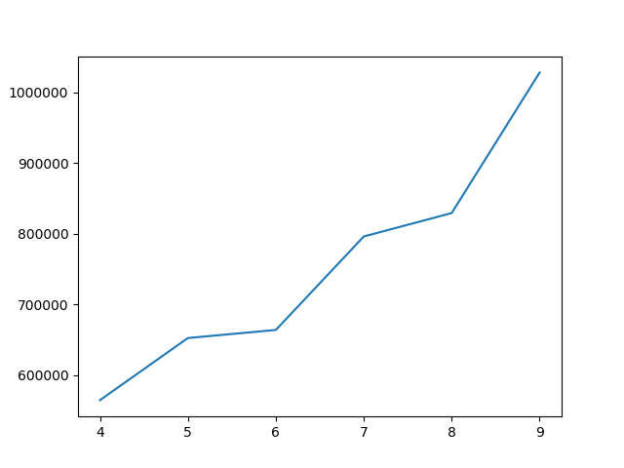
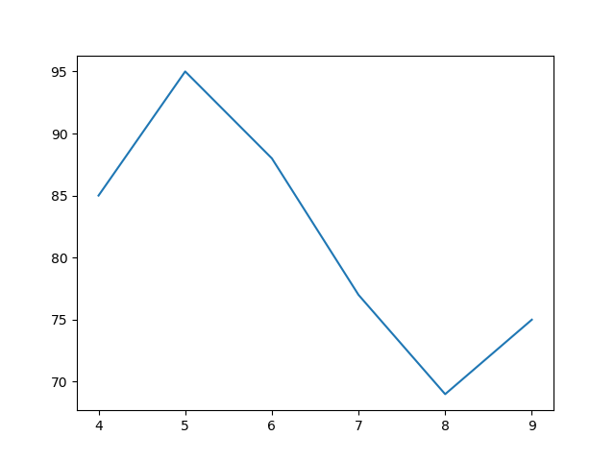
Uber mONthLY reSULTS VS YELLOW TAXI MONTHly RESULTS

Slide 8
CONCLUSION

